Slide 1
Hypothalamus
Hypothalamus: in brain releases GnRH
Anterior Pit
Anterior Pit: Releases LH and FSH into blood
Blood
FSH
LH
Surge in FSH and LH causes Follicle to Ovulate
Ovary
Ovary Produces Estrogen and Progestin
Estrogen
Progesterone
Estrogen: Used in post menopausal women who have a decrease in Estrogen (aids in prevention of osteoporosis
Progesterone is involved in menstrual cycle, pregnancy (supports gestation) and embryogenesis
Progestin (Progestin is synthetic progesterone)for Contraception and endometriosis
Estrogen surge
Follicular Phase
Thickening of endometrium

Slide 2
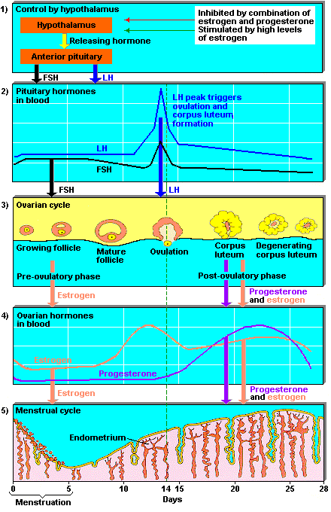
Menstrual Cycle
Follicular Phase
1. Menstruation
Day 1: Bleeding
Day 5: end of bleeding
2nd half of Follicular Phase
Day 6: increase FSH = follicle growth
Day 13: endometrium growth
Ovulation Phase:
Day 14: LH surge
FSH surge
Follicle ruptures out oocyte
Prime time for SEX
Luteal Phase:
Day 15 – 28: most stable phase
Thickening of endometrium
if no implantation: corpus luteum degen
if implant: Human Chorionic Gonadotropin (hCG) from placenta prevents corpus luteum from degenerating

Slide 3
Contraception Hormones
Estrogen:
1. Stabilize endometrial Lining
2. Suppresses FSH due to negative feedback
suppressed FSH leads to no ovulation
Progestins
1. Alters endometrial lining of fallopian tube → increase mucus
2. Suppress LH due to negative feedback
Suppressed LH leads to no ovulation
3. Some estrogenic activity → increase estrogenic activity of contraceptive
4. Androgenic activity (structure is similar to testosterone)
Acne, hirsutism

Slide 4
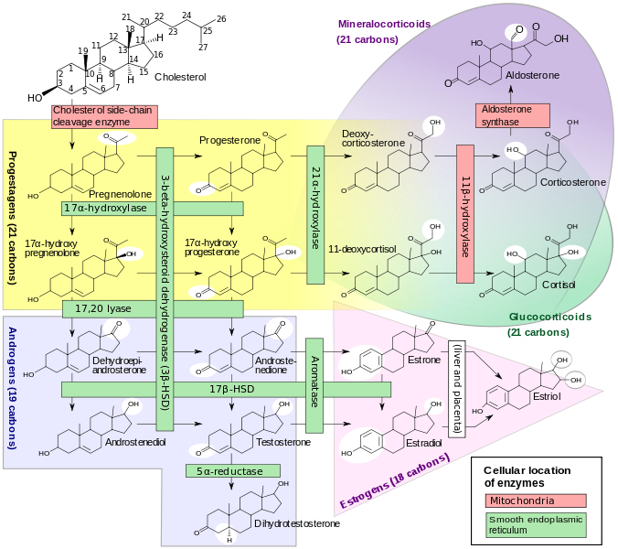

Slide 5
Pros of Combined Oral Contraceptives (COC)
Cons of COC
Won’t get pregnant
Relief from menstruation symptoms
Estrogen = less hair, less acne
Androgen = more hair, more acne
3. Improved acne
4. Prevent diseases
Ovarian Cancer
Ovarian Cysts
Endometrial Cancer
Pelvic inflammatory disease
Benign Breast disease
May elevate BP
Mild risk of thrombo
Increase risk of MI
Condition | Estrogen | Progestin
Osteo | Good | Good
Decrease LDL |  | Good
Colorectal Cancer |  | Good
DVT/PE | Bad | BAD
Stroke | BAD | bad
Breast CA |  | Bad
MI |  | bad
Absolute Contraindications
Heavy Smokers > 15 cigs/day + Age > 35 y/o
b/c of CV risk (especially MI)
HTN > 160/100
CV disease
Hx thromboembolic disease
CAD
Breast Cancer
Undiagnosed Uterine Bleeding
Relative Contraindications
Smoking > 15 cigs/day
Breast feeding (estrogen in milk)
HTN
Hx Migraine disorder
Tumors in uterus
DM
Notes:
160/100 six for sex stage 2 HTN

Slide 6
Synthetic Estrogens:
Ethinyl Estradiol
Less side effects at a low dose of 25 mcg (bloating, breast tenderness)
Max dose: 35 mcg
Cons: Estrogen increases CV risk

Slide 7
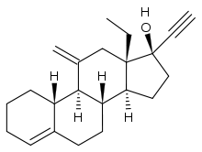
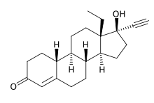
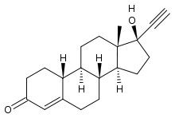
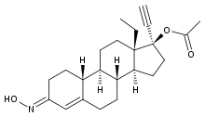
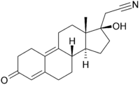
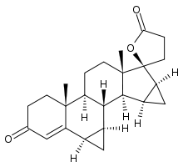
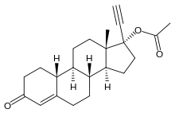
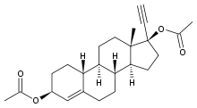
Synthetic Progestins:
More Androgenic | Less Androgenic
1st Generation | 2nd Generation | 3rd Generation | 4th Generation
Norgestrel | Levonorgestrel (left) | Desogestrel (prodrug metabolized to active Etonogestrel) | Drospirenone (Yaz) Avoid if patient has kidney disease b/c of increase in K
Norethindrone |  | Norgestimate | Dienogest
Norethindrone Acetate (prodrug)
Ethynodiol Diacetate
Notes:
Third-generation oral contraceptives are suitable for use in patients with diabetes or lipid disorders because they have minimal impact on blood glucose levels and the lipid profile. Their synthetic estrogen dosage is lower than second-generation oral contraceptives, reducing the likelihood of weight gain, breast tenderness and migraine.

Slide 8
1st gen
___Norgestrel Norethindrone
2nd gen
Levonorgestrel
3rd gen
Norgestimate
Desogestrel
4th gen
Drospirenone
Dienogest

Slide 9
Type of Oral Contraceptives (OC)
Monophasic: Fixed dose of estrogen and progestin
Multiphasic
Biphasic, Triphasic, 4-phasic: Reduce dose of progestin
thought to have fewer side effects than monophasic (eh?)
Cycle Packs | Active Pills | Placebo | Pros | Cons
28 day pack | 21 | 7 | Standard
21 day pack | 21 | 0 | No need to take placebo | Forget = bad
24/4 pack Loestrin 24 Fe | 24 | 4
 | 26 | 2 | Shorten period
Extended Cycle | Active Pills | Placebo | Pros | Cons
Seasonale Seasonique | 84 (3 months) | 7 | Less bleeding Pts with anemia | unnatural
Lybrel | 28 forever |  | No breakthrough bleeding

Slide 10
Progestin Only (minipill)
Pros:
Avoids estrogen related side effects
**May be used in breastfeeding women**
May be used in women with CV risk
protects against
a. Pelvic inflammatory disease is a general term for infection of the uterus lining, fallopian tubes, or ovaries
b. iron deficiency anemia b/c less bleeding
c. dysmenorrhea: gynecological medical condition of pain during menstruation that interferes with daily activities
Cons:
Less effective than combo
Continuous administration (no hormone free interval)
Must be taken on time (3 hr late = take the pill ASAP + additional contraception)
Irregular menstrual cycles (frequent spotting)

Slide 11
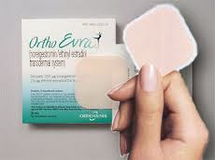
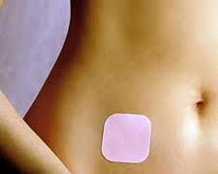
Transdermal Contraceptive
Use: apply once weekly for 3 weeks + Patch free week
Apply to 1 of 4 areas:
1. Lower abdomen or
2. Butt or
3. upper outer arm or
4. upper torso (no breast)
Pros: easy dosing
Cons: higher risk of DVT 10/10,000 vs 6/10,000 (COC)
 | Estrogen | Progestin
Ortho Evra | 0.02 mg/day Ethinyl estradiol | 0.15 mg/day Norelgestromin
Injectable Hormone Contraceptives
Pros: Safe for breastfeeding
use every 3 months
Cons: must visit doctor
 | Drug | Dose
Depo SQ Provera | Medroxyprogesterone | 104 mg/0.65 ml
Depo Provera IM | Medroxyprogesterone | 150 mg/1ml
Notes:
whateVa patch

Slide 12
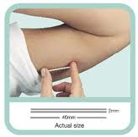
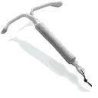
Implantable Devices
Pros: Lasts 3 years
can breast feed
Cons: must be implanted by health professional
 | Drug
Nexplanon | Etogestrel
Intrauterine Device
Pros: Lasts years
safe for those with CV risks
can breast feed
safe for obese
Mirena
 | Drug | Dose | Comments
Mirena | Levonorgestrel | 20 mcg/day | Lasts 5 years
Paragard T 380A | Copper Hormone free |  | Lasts 10 years (longest) Copper works as a functional spermicide inhibiting sperm motility and acrosomal enzyme activation.
Notes:
Nexplanon nexPLANTon
Mirena = My – rena = MY uteRINEa

Slide 13
Emergency Contraception (EC): morning after pill
Drug: Progestin only
MOA:
1. prevents ovulation
2. thickens cervical mucus
SE: fatigue, abdominal pain, headache, breast tenderness, nausea
 | Drug | # days after sex | Facts
Plan B One-Step | Levonorgestrel 1.5 mg | 2 days Within 24 hr is best | Normal OC is 0.1 mg
Next Choice | Levonorgestrel 0.75 mg BID | 2 days Within 24 hr is best | Normal OC is 0.1 mg
Ella | Ulipristal Acetate 30 mg | 5 days | New MOA: blocks progesterone so that there is no progesterone to protect the endometrium

Slide 14
Patient Counseling
When to start:
Quick Start: Start anytime
Day 1 Start: 1st day of menses
Sunday Start: When period starts, take pill on that Sunday
When it starts working: Starts working in 1 week
ACHES |  | Possible Reason
A | Abdominal Pain | Gallbladder, Liver tumor, pancreatitis
C | Chest Pain/SOB | PE, MI
H | HA | Stroke, BP
E | Eye problem Blur/flashes | Stroke, BP
S | Severe leg pain | DVT

Slide 15
Q&A
Question/Complaint Answer
Just started and I’m bleeding man Chill. Come back in 3 months (3-4 cycles)
I’m bleeding before finishing my active pill Late Cycle = increase progestin
I’m bleeding after menses Early Cycle = increase estrogen
I’m bleeding midway all day everyday increase estrogen and progestin
I’m a hairy girl with oily skin switch to 3rd or 4th generation progestin
My stomach hurts… take it with food
I have a headache D/C COC because you might have a STROKE!
GO TO THE ER!
Or lower estrogen and progestin dose
LDL is too high… increase estrogen (it helps)
Estrogen decreases LDL
Androgen increase LDL
My breast is tender it occurs in 30% of women and 0% in men
decrease estrogen
10. I’m bloating? Decrease estrogen and progestin

Slide 16
I missed a pill
How many?
2 Pills
(2 days late)
1 Pill
(1 day late)
During
Week 1-2
During
Week 3-4
Take ASAP
Continue on
Take 2 today
Take 2 tomorrow
Start a new pack
Backup contraception
For 1 week

Slide 17
Vaginal contraceptive ring
Use: women self inserts ring into vagina 5 days before menses
NuvaRing: Ethinyl estradiol + etogestrel
Duration: use for 3 weeks, HFI for 1 week
SE: Headache, vaginal discharge, vaginitis, irritation. Rare and serious side effects are similar to combined oral contraceptives.
Miss Dose
Week 1
Week 2-3
Removed for
< 3 hr
Removed
> 3 hr
Removed
< 72 hr
Removed
> 72 hr
Reinsert ASAP
continue
Reinsert ASAP
Backup for 7 days
+
EC if sex within 5 days
Reinsert ASAP
Continue
Reinsert ASAP
Continue
+
Backup for 7 days
Start next ring
With NO HFI
Start next ring
With NO HFI
Notes:
EC = emergency contraceptive
HFI = hormone free interval

Slide 18
D-D Interactions
Class | Drugs | Mechanism | Effect | Solution
Anticonvulsants | Carbamazepine Phenytoin Phenobarb Primidone Topiramate | Induce CYP Increase metabolism of COC | Decrease effect | EE Dose should be > 35 mcg
Antifungal | Griseofulvin | ↑ metabolism | Decrease Effect | Backup method
TB Mycobacteria | Rifampin Rifabutin | ↑ metabolism | Decrease Effect | Backup method
Penicillins Tetracycline Erythromycin | Amoxicillin Ampicillin Doxycycline Minocycline | Kil GI bacteria reducing liver recirculation of estrogen | Decrease Effect | Backup for 1 week
Narcolepsy | Modafinil | ↑ metabolism | Decrease Effect | Backup method
HIV Protease inhibitors | Amprenavir Nelfinavir Lopinavir Saquinavir ritonavir | Increase or decrease serum levels of estrogen and progestins | Decease efficacy of COC Increase side effect of COC | Backup method
Da Herbs | St. John’s Wort | Induce CYP | Decrease Effect | Backup method

